Slide 1

Vehicle No Plate Detection
Name:Rahul Kumar Singh

Slide 2
CONTENTS
Introduction
Processes a software undergoes to detect and recognize a license plate
Creating a license plate detection and recognition program
Results

Slide 3
Introduction
01
License plate detection and recognition is the technology that uses computer vision to detect and recognize a license plate from an input image of a car.
This technology applies in many areas. On roads, it is used to identify the cars that are breaking the traffic rules. In security, it is used to capture the license plates of the vehicles getting into and out of certain premises. In parking lots, it is used to capture the license plates of the cars being parked. The list of its applications goes on and on.
Python will be our programming language.
Pycharm Community edition as our IDE

Slide 4

Processes a software undergoes to detect and recognize a license plate
Taking an image of a car as input
The program takes in the input of the car in which the license plate is to be detected.
Processing the input
The image taken as the input undergoes processing to detect the part of the car that is the license plate
Recognizing the number plate
The values of the detected license plate are extracted from the number plate image.

Slide 5
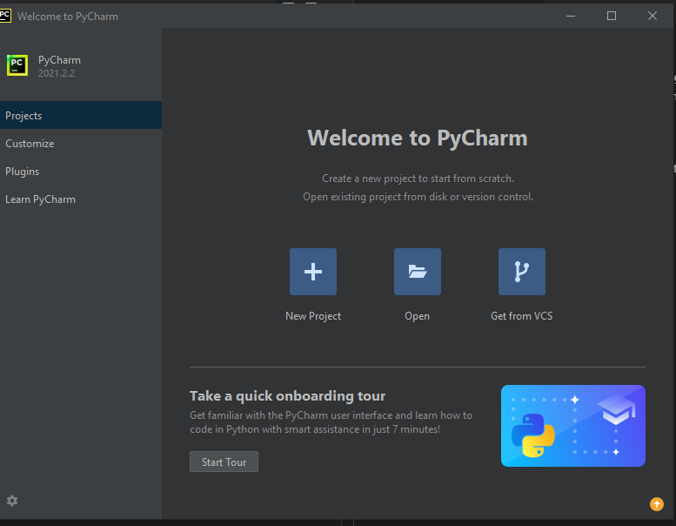
First things first, lets prepare our workspace. Open pycharm and click on create a new project .
Now we have to install certain libraries
> pip install opencv-contrib-python
We will use it to preprocess our image and also display the images that have undergone processing.

Slide 6
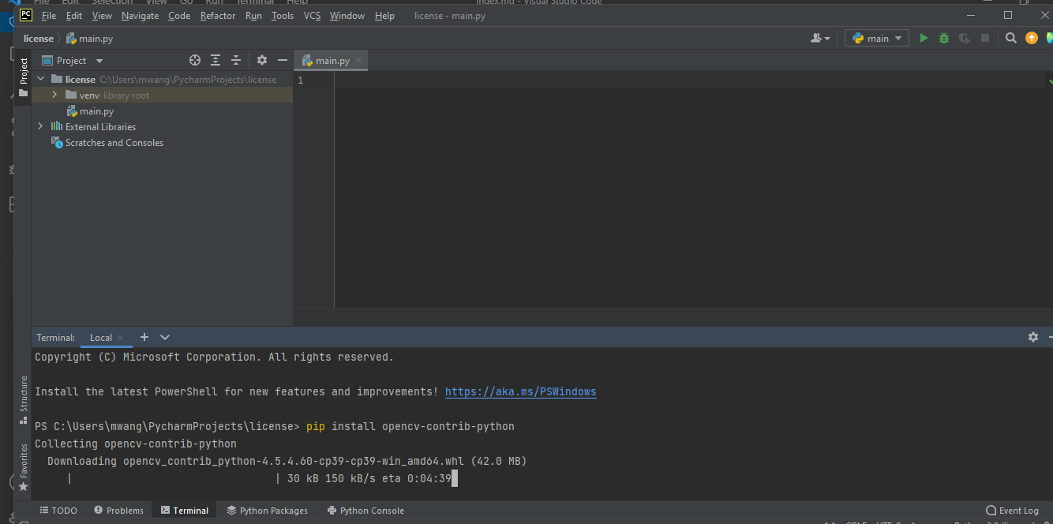
Other libraries that we need to install are
>pip install imutils
We will need this library to resize our images.
>pip install pytesseract
We will need this library to extract the license plate text from the detected license plate.

Slide 7
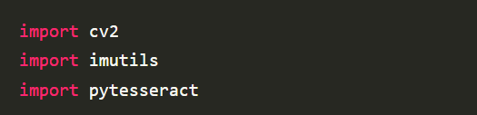
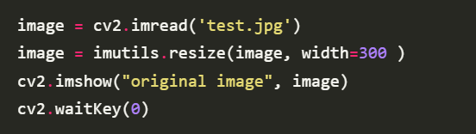
Importing the libraries
Now Specifying the path to which tesseract is installed
pytesseract.pytesseract.tesseract_cmd = 'C:\Program Files\Tesseract-OCR\\tesseract'
Taking in our image input and resizing its width to 300 pixels

Slide 8
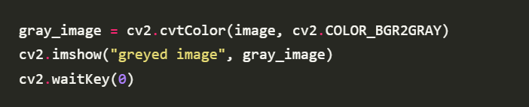
image = cv2.imread('test.jpg'): We are taking in the image as our input. test.jpg is the name of the image.
image = imutils.resize(image, width=300 ): We are resizing our image. image is the image we took as input. For width=300 we are resizing the width of that image to 300 pixels.
cv2.imshow("original image", image): We are displaying the image after setting its width to 300 pixels. original image is the name of the window that displays the image.
Converting the input image to greyscale
gray_image = cv2.cvtColor(image, cv2.COLOR_BGR2GRAY): We are creating a variable gray_image.
We are then passing our input image to cv2.cvtColor. cv2.COLOR_BGR2GRAY specifies that the image should be converted to grey image.
cv2.imshow("greyed image", gray_image): We are displaying the image which is already converted to grey.

Slide 9
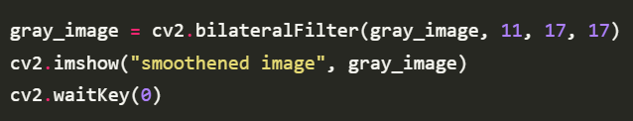
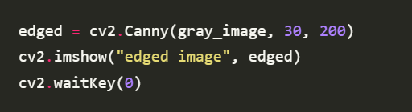
Reducing the noise in the greyscale image
gray_image = cv2.bilateralFilter(gray_image, 11, 17, 17): We are reducing the noise in the grey image hence smoothening it.
cv2.imshow("smoothened image", gray_image): We are displaying the already smoothened image.
Detecting the edges of the smoothened image
edged = cv2.Canny(gray_image, 30, 200): We are creating variable edged. We are then passing our smoothened image to cv2.canny to detect the edges in it.
cv2.imshow("edged image", edged): We are displaying the image with the detected edges.

Slide 10
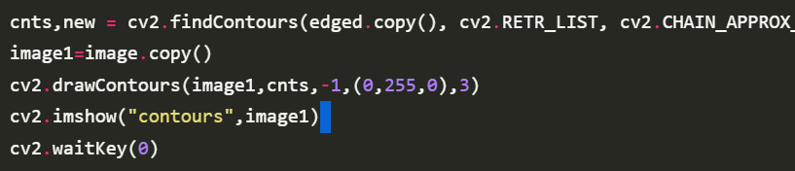
Finding the contours from the edged image
cnts: This represents the contours.
RETR_LIST: It retrieves all the contours but does not create any parent-child relationship.
CHAIN_APPROX_SIMPLE: Removes all the redundant points on the contours detected.
image1=image.copy(): We are making a copy of the original input image. This is because we do not want to change the original image.
cv2.drawContours(image1,cnts,-1,(0,255,0),3): We are drawing the identified contours on our image. Input the values as they are.
cv2.imshow("contours",image1): We are displaying the image with the identified contours drawn around it.

Slide 11
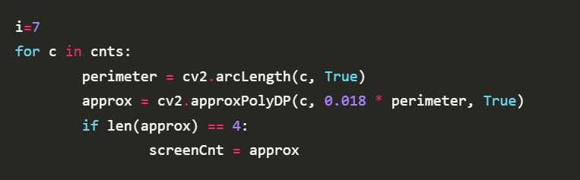
Finding the contour with four sides
for c in cnts: : We are creating a for loop over the contours we did sort. This is to find the best contour of our expected number plate.
perimeter = cv2.arcLength(c, True): Perimeter is also referred to as arclength. We are using the arclength function to find it.
cv2.approxPolyDP(c, 0.018 * perimeter, True): ApproxPolyDP approximates the curve of polygon with precision.
if len(approx) == 4:: chooses the contours with four sides as this will probably be our number plate.

Slide 12
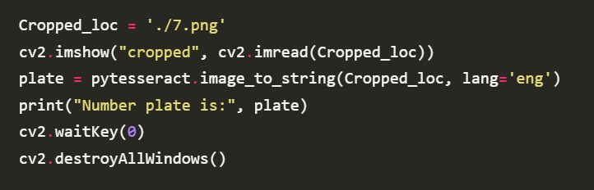
Extracting text from the image of the license plate
Cropped_loc = './7.png': This is the file name of the cropped image of the license plate.
cv2.imshow("cropped", cv2.imread(Cropped_loc)): We are displaying the image of the cropped license plate part.
plate = pytesseract.image_to_string(Cropped_loc, lang='eng'): We are passing the image of the cropped part of the license plate. We are then calling on pytesseract to extract the text on the image.
print("Number plate is:", plate): We are printing out the extracted text.
cv2.destroyAllWindows(): We are closing all the open windows.

Slide 13
Result
Hence we created a program that detects and recognizes license plates. Capture more images of vehicles and input them into the program and does its magic.

Slide 14
Thank You

